Slide 1

Project One: Group D3
Al Burroughs, Albe Eteme, Jane Kim, & Chidozie Nwagbo

Slide 2
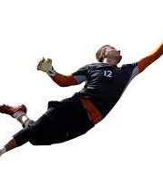
Proposal & Background
Goalkeeper’s performance and its effect on the team/clubs win or lose percentage
> Establish a direct relationship between the saves made by a goalkeeper in a game and the clubs/teams win or lose percentage

Slide 3
Questions?
Which club performed the best in a specified time period?
Does the amount of time a goalkeeper plays correlate with his performance ?
What is the average of shots saved vs. shots faced between goalkeepers?
What goalkeeper stats impact the chances of a team winning or losing?

Slide 4
Data Sources
Kaggle.com was the source for the datasets used in this presentation. The Kaggle datasets provided the information best suited for this project within the time constraints for data discovery.
Global data for the scope of this project is limited. Statistical data created by Major League Soccer (MLS) in the United states ultimately turned out to be the best source .
The primary data set provided goalkeeper information. The remaining datasets provided information about other team players.

Slide 5
Data Exploration
Major League Soccer (MLS) - Goalkeepers
Datasets included data on all players from the years 1996-2019

Slide 6
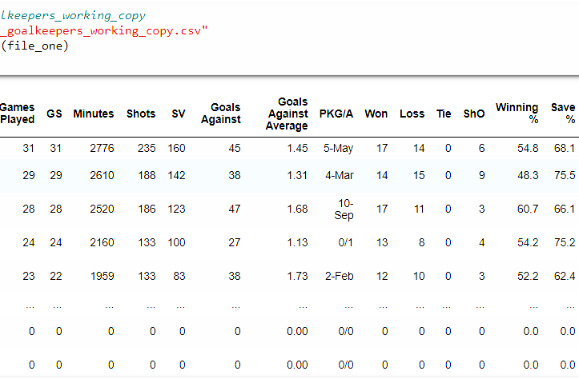
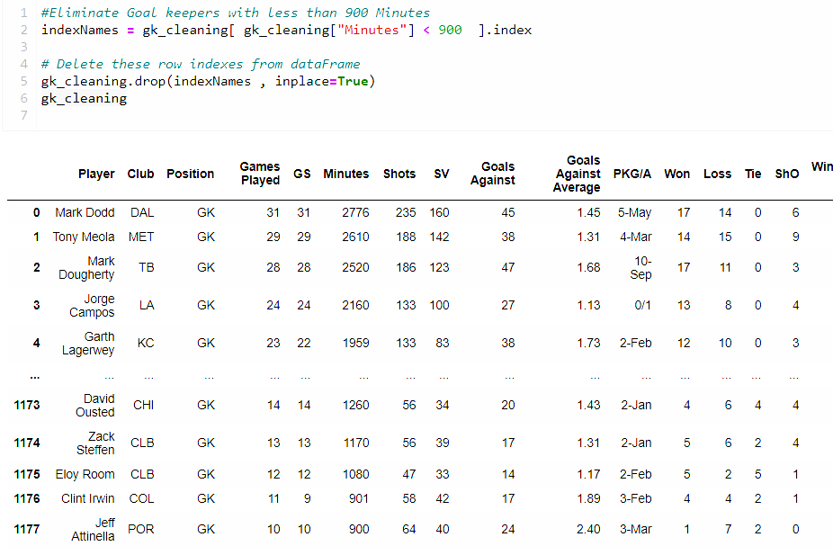
Data Cleanup
Cleaning the data required the elimination of the following:
Years 2020 and 2021 due to COVID-19
All post season statistics
All players who played < 900 minutes. This provided more continuity in the data sets.
Winning Percentage was recalculated.
This was done by incorporating a formula which included data for “Ties” This had an affect on the win/loss ratio.
The "ShO“ (shootout) column was also eliminated due to the values being too small.

Slide 7
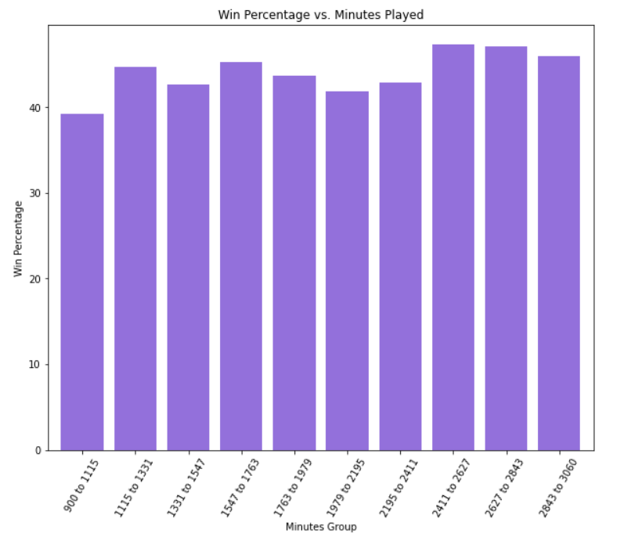
Goalkeepers Time Played vs. Win Percentage
Relationship between the amount of time a goalkeeper played (Minutes Group) and the goalkeeper’s average win percentage.

Slide 8
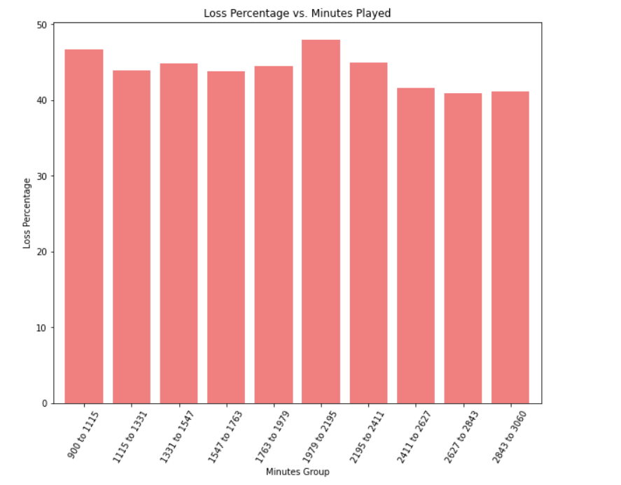
Goalkeepers Time Played vs. Loss Percentage
A slight correlation can be seen between the win percentage and a goalkeepers’ time on the field.

Slide 9
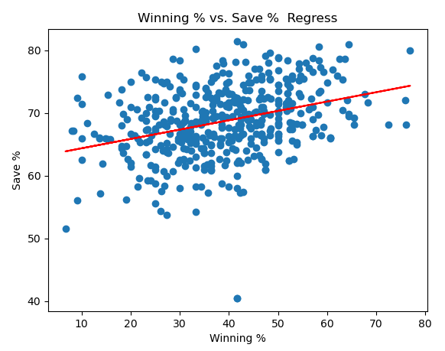
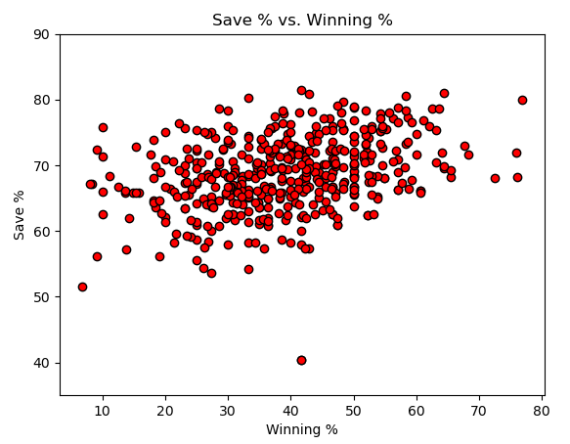
Regression Model
As the winning percentage vs. save percentage goes up, the goals against average mean goes down.

Slide 10
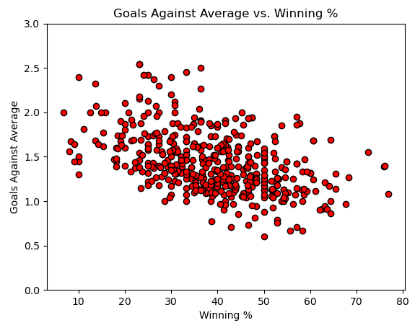
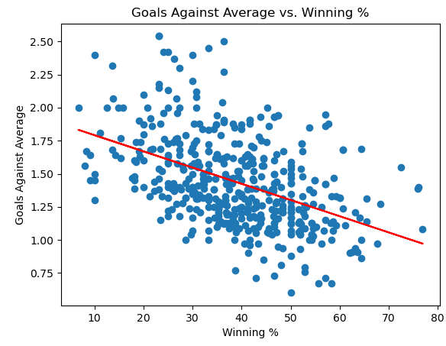
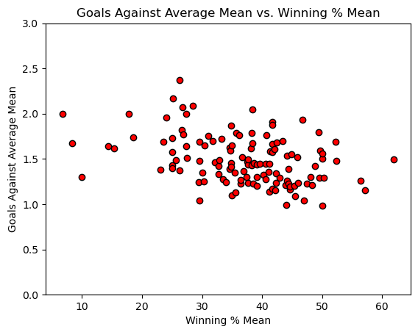
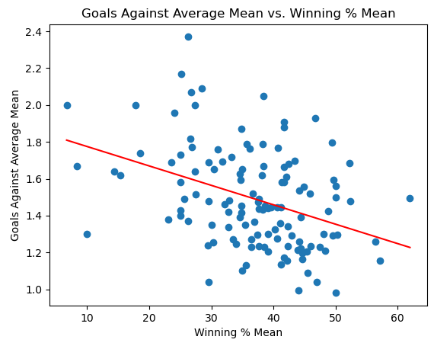
Goals Against Average vs. Winning Percentage
As the goals against average goes down, the winning percentage goes up.
When we narrowed down the players, the significance of the correlation coefficient decreases because there are less results, but the overall linear regression stays the same.
*All goalkeepers played a minimum of 900 minutes
(with multiple games)
Average of All goalkeepers

Slide 11
Discussion & Findings
Recalling our presentation was made around the importance of the goalkeeper’s performance and their team's winning percentage.
Goalkeepers that played more minutes have better save percentages.
As the winning percentage and its mean go up, the goals against average and its mean go down.
As the save percentage per goalkeeper goes up, the winning percentage of his team goes up.
Goalkeeper’s performance has an impact on the team winning percentage in MLS.

Slide 12
Postmortem
One of the csv files in Kaggle showed only team names with no abbreviations.
There was lack of time to go through all the team names of one of the datasets and replace them with their club names.
Some data was wasn't necessary to show our hypothesis
We could only find relevant data from the US.
More time was required to find data from other countries to develop a larger dataset.

Slide 13

Questions Q&A

